Slide 1
Capturing Emerging Behaviour in Multi Neighbourhood CA using EC

Slide 2
Theoretical and Experimental setup for MNCA

Slide 3
What is MNCA?
We know classical CA
Born and Survive rules for example B/3 and S/23 for GoL.
There are bunch of other known rules [1]
Multi Neighborhood CA
Rather than having single nh BS rules, we follow chains of rules
Extension of traditional CA
nh1 = [(upper,lower,Life/death), (upper,lower,Life/death)]
nh2 = [(upper,lower,Life/death), (upper,lower,Life/death)]
nh = [nh1,nh2]

Slide 4
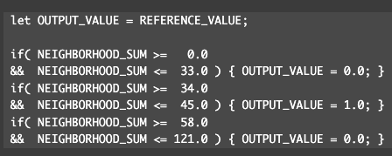
Implementation Details – Cellular Automata
Input to CA function
Now the B and S rules are transformed to B and D rules with the meaning Born and Death, where Born array or B contains rules like [[-,-],[-,-],[-,-]...] and same with D.
D = [[0,33],[58,121]] and B = [[34,45]] And our EC will evolve these lists now, rather than B and S which I had mentioned earlier.

Slide 5

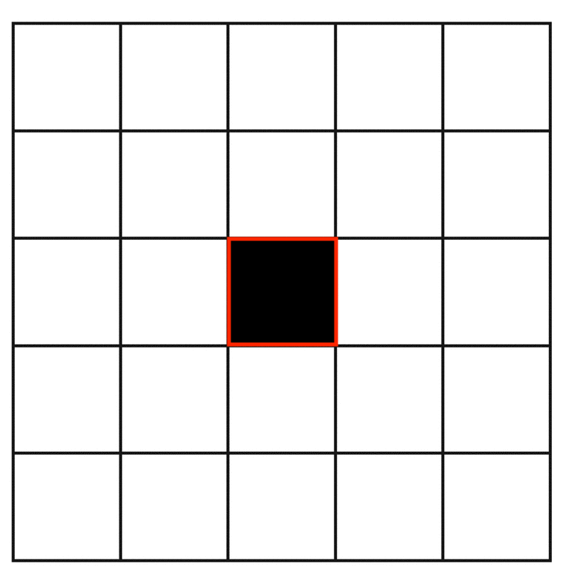
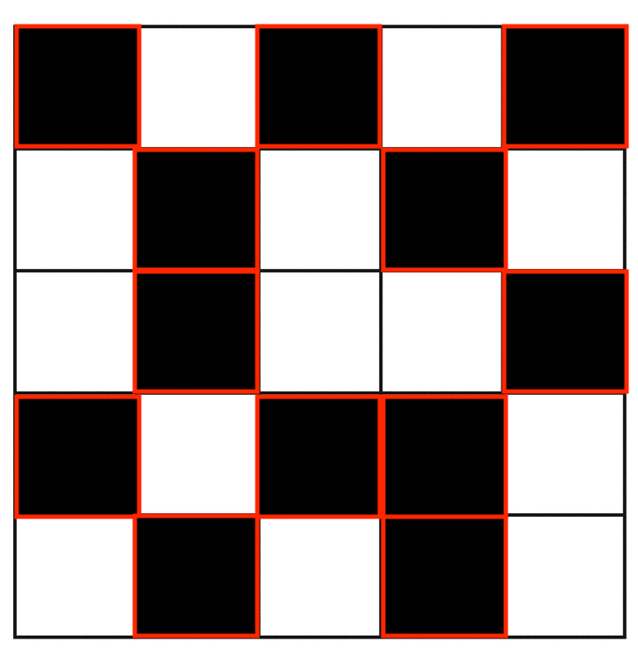
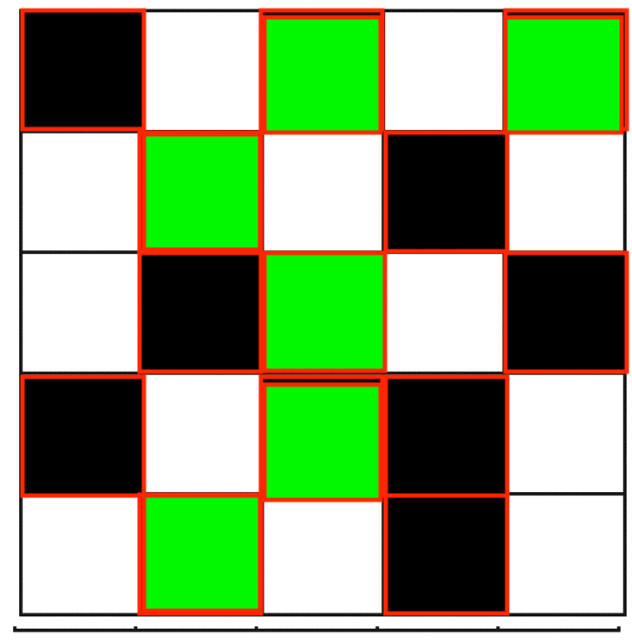
Implementation Details – Cellular Automata
Initial States
Single Active Cell
Random with probability (0,1)
Random with probability (0,1,2)

Slide 6
Implementation Details – Cellular Automata
Fixed Parameters for CA
W = 100
H = 100
Border Conditions = Wrap around or modulo like (we have not fixed the boundary of CA)
init_state = {‘single_cell’, ‘01_rand_probabstic’, ‘012_rand_probastic’}
For CA Steps
Case1: CA Steps = 1-50
Case2: CA Steps = 51-100

Slide 7
Implementation Details CA Rules – Slackermanz like
Evolve or Learn Rules and Fix Neighbors
Single Neighborhood

Slide 8
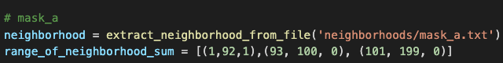
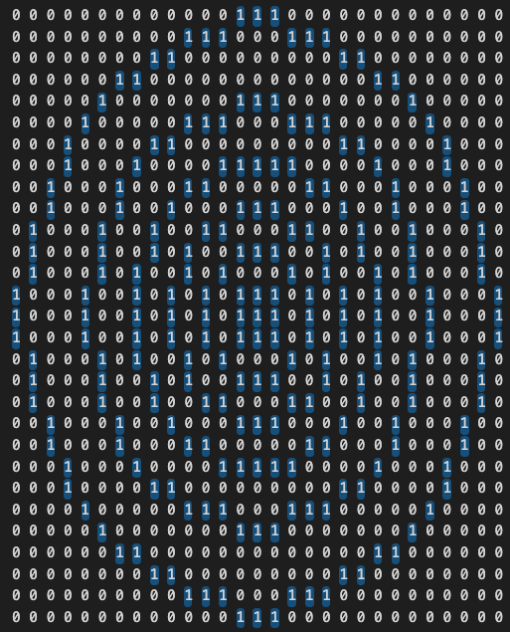
Implementation Details CA Rules – Single Neighborhood
Evolve or Learn Rules and Fix Neighbors
Fix Neighbors, n=1.
Fixing 1 neighbors
Board
Initialization
=
Known neighborhood and rules [2]
200x200
Steps=100
1 Neighborhood CA
nh1

Slide 9
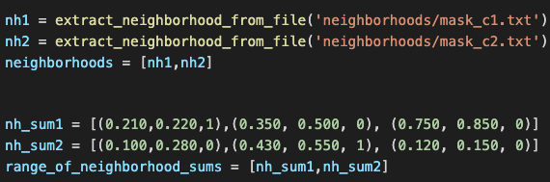
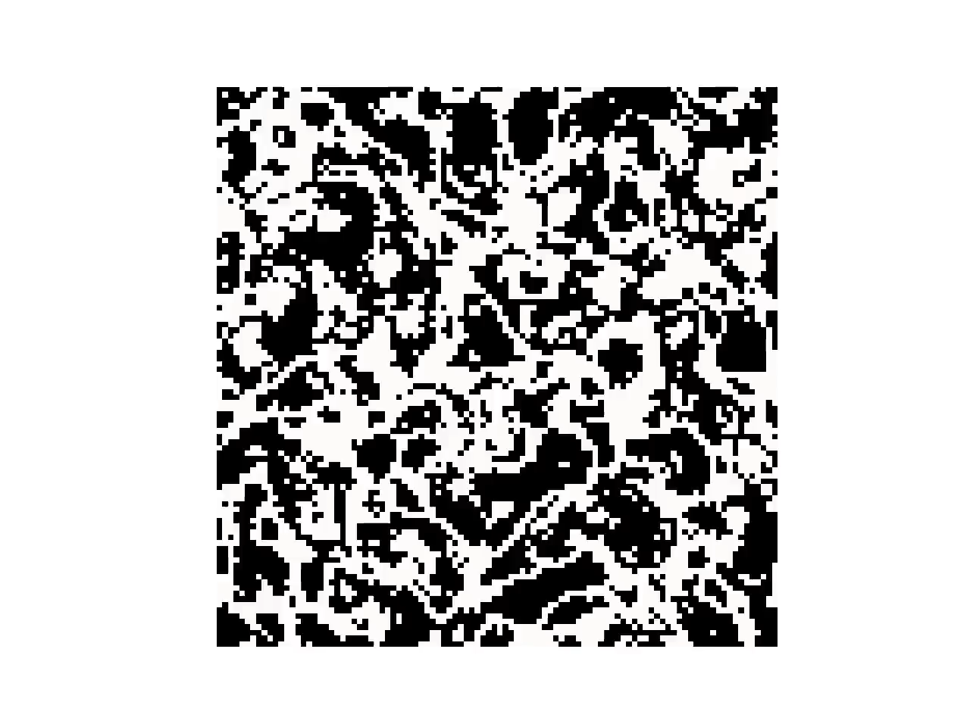
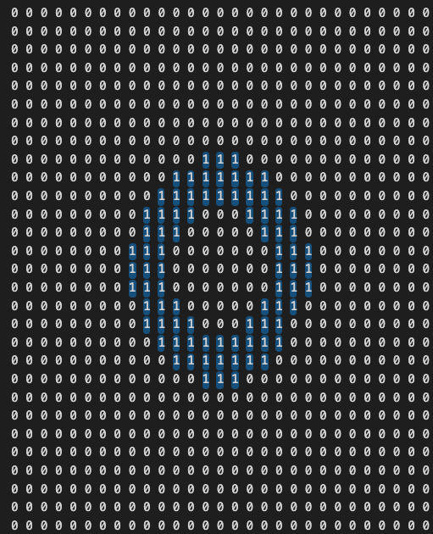
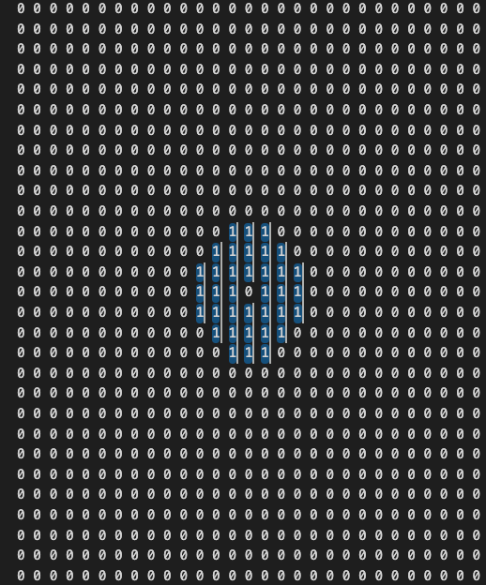
Implementation Details CA Rules – Multi Neighborhood
Evolve or Learn Rules and Fix Neighbors
Fix Multiple Neighbors, n=2
Fixing multiple neighbors
Board
Initialization
There is flexibility to add more neighbors
=
+
Mask_c1.txt
Mask_c2.txt
Ran for 200 steps (100x100)
Known Rule from Slackermanz[2]

Slide 10
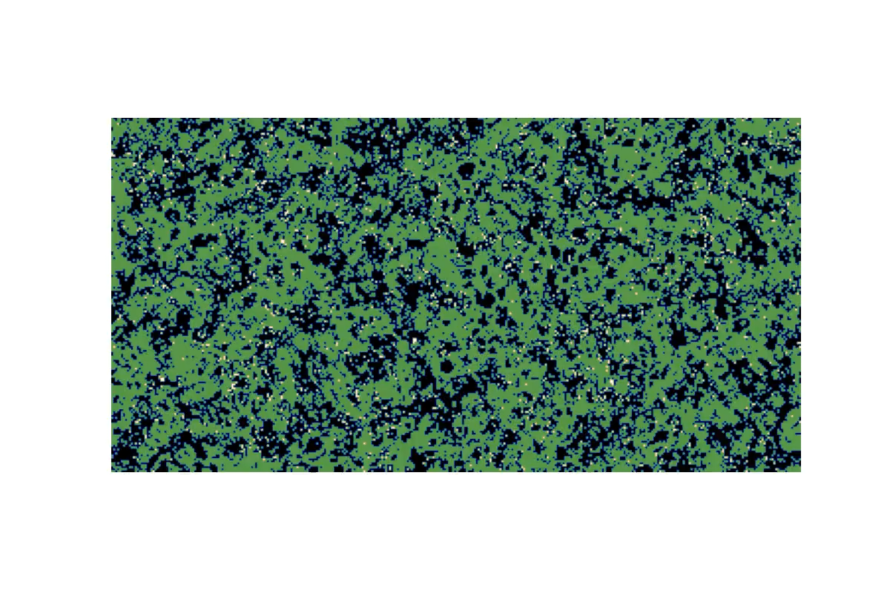
Known rule! And Why?(To verify!)
nh_avg1 = [(0.185,0.200,1),(0.343, 0.580, 0), (0.750, 0.850, 0), (0.150, 0.180, 0)]
nh_avg2 = [(0.150,0.280,0),(0.445, 0.680, 1)]
w=350, h=180,
steps = 600,
fps = 20,
random cell with probability (3 states)

Slide 11
Theoretical and Experimental setup for Evolutionary Computation

Slide 12
Implementation Details – EC – GA operators
Init Population
Calculate Fitness (Not revealed for now)
Just think fitness for now as Frequency Count of active cell!
Selection – Proportionate Selection / Roulette Wheel
Population[], Fitness[] ➔ probability of each fitness ➔cumulative probability ➔ flip a coin ➔ if(randomvalue<cumulative_p[index]) select index
Crossover – skipped for now

Slide 13
Implementation Details – EC - Mutation
Update Mutation with following changes
Inserting a value in the bound /tuple("Gene") by using clone and mutate, because to find probability of adding a new gene to the rule should be based on the probability of already existing gene.
Remove a value from the rule based on probability of the gene / value already there in the rule. (Removing a tuple)
Change a value from the rule based on probability of the gene / value already there in the rule. (Changing value inside tuple with a delta – fixed or uniformly sampled)

Slide 14
Fixed EC details for experiment
POPULATION_SIZE = 10
GENERATION_SIZE = 10
Genotype Details – for generating population
NUMBER_OF_NEIGHBORHOODS = 2 # for random number of nh put random function here
NUMBER_OF_BOUNDS_IN_EACH_NEIGHBORHOOD = 3 # for random number of nh bounds put random function here
Mutation Details
OVERALL_PROBABILITY_ATLEAST = 1 # or 2,3,4…
total_sum = 3*POPULATION_SIZE*NUMBER_OF_NEIGHBORHOODS*NUMBER_OF_BOUNDS_IN_EACH_NEIGHBORHOOD
PROBABILITY_OF_INSERTING_A_NEW_RULE = OVERALL_PROBABILITY_ATLEAST/total_sum
PROBABILITY_OF_REMOVING_A_RULE = OVERALL_PROBABILITY_ATLEAST/total_sum
PROBABILITY_OF_CHANGING_A_RULE = OVERALL_PROBABILITY_ATLEAST/total_sum

Slide 15
A pictorial explanation for a population
[
[ [(_,_,_), (_,_,_), (_,_,_), (_,_,_)],
[(_,_,_), (_,_,_), (_,_,_), (_,_,_)],
[(_,_,_), (_,_,_), (_,_,_), (_,_,_)]
],
[ [(_,_,_), (_,_,_), (_,_,_), (_,_,_)],
[(_,_,_), (_,_,_), (_,_,_), (_,_,_)],
[(_,_,_), (_,_,_), (_,_,_), (_,_,_)]
],
]
[] = POPULATION = 2 [], []
[] = NEIGHBORHOODS AVG/SUM= 3 [], [], []
[] = BOUNDS IN EACH NEIGHBORHOOD =
4 (), (), (), ()
Chromosome/Individual

Slide 16
A pictorial explanation for a population
[
[
[(0.745, 0.791, 0), (0.107, 0.892, 0), (0.739, 0.942, 1), (0.95, 0.962, 0)], [(0.752, 0.983, 1), (0.205, 0.954, 0), (0.637, 0.874, 1), (0.132, 0.864, 0)], [(0.646, 0.666, 1), (0.749, 0.87, 1), (0.469, 0.921, 1), (0.748, 0.834, 0)]
],
[
[(0.698, 0.769, 1), (0.083, 0.771, 1), (0.871, 0.987, 0), (0.111, 0.391, 1)], [(0.696, 0.918, 0), (0.717, 0.965, 1), (0.371, 0.935, 0), (0.616, 0.761, 1)], [(0.024, 0.172, 1), (0.738, 0.857, 1), (0.721, 0.874, 1), (0.219, 0.941, 0)]
]
]
[] = POPULATION = 2 [], []
[] = NEIGHBORHOODS AVG/SUM= 3 [], [], []
[] = BOUNDS IN EACH NEIGHBORHOOD = 4 (), (), (), ()
Bounds can also be kept random

Slide 17
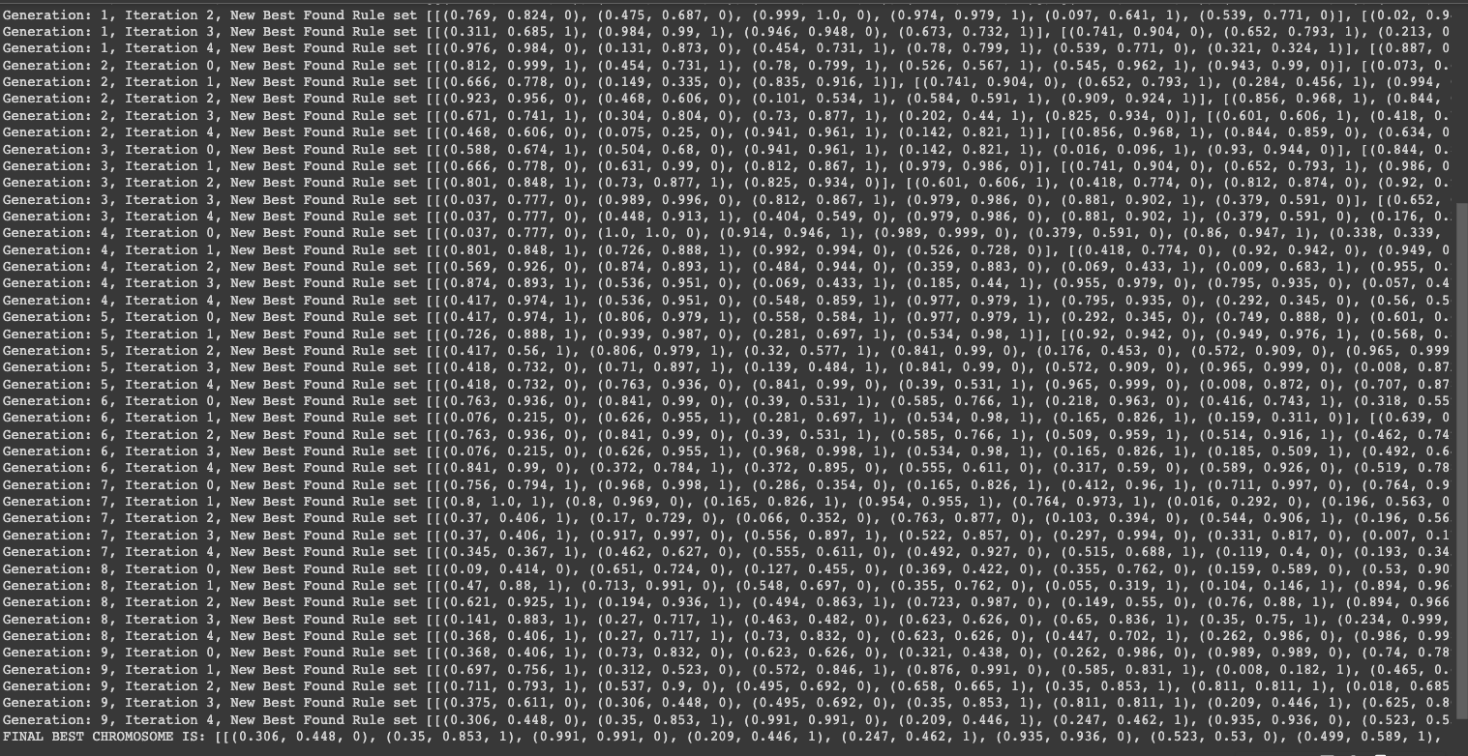
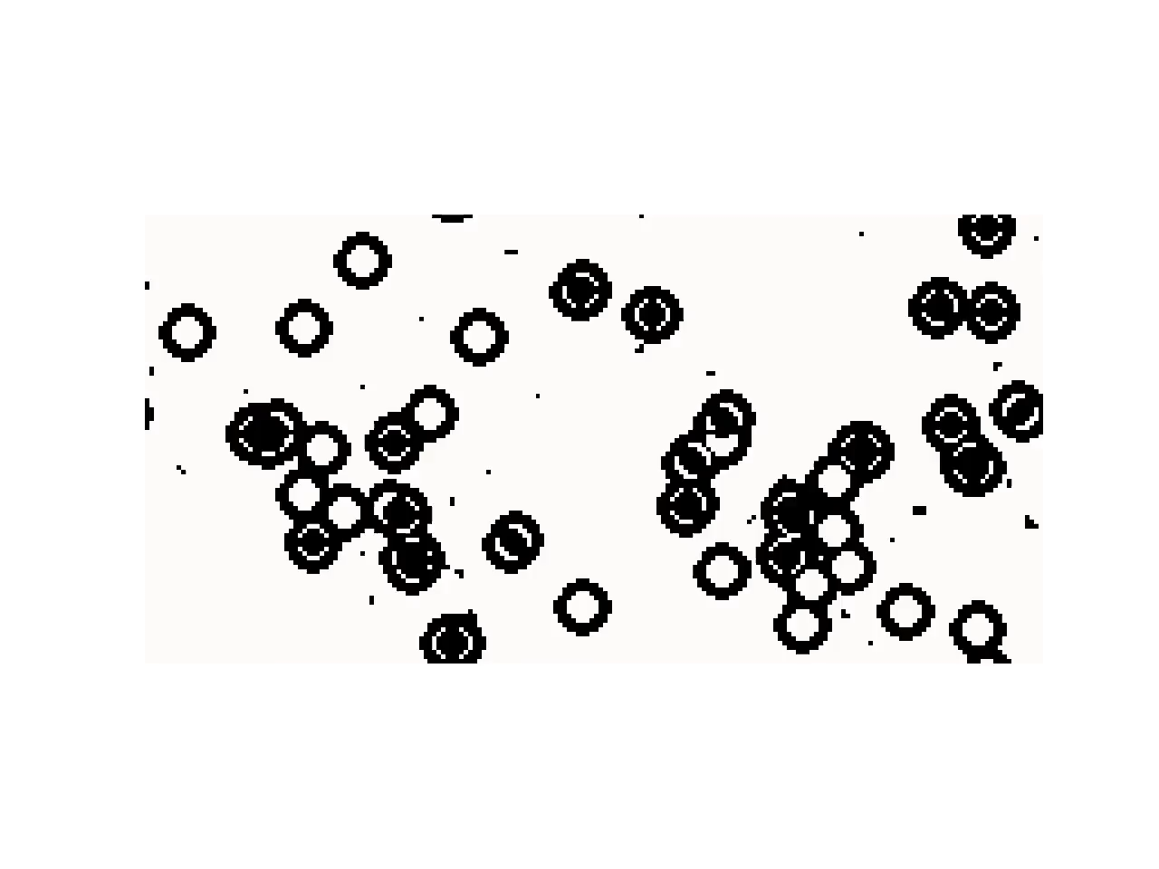
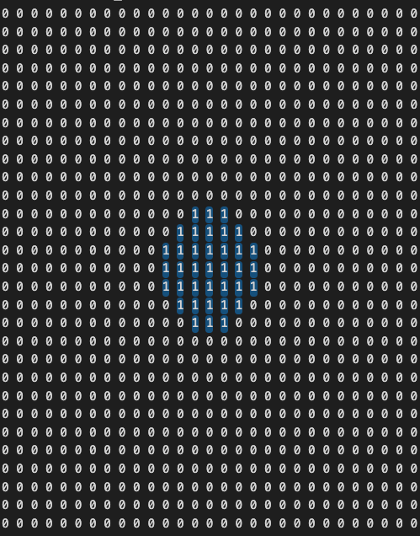
Population = 10, Generation = 10, nh=2
Output

Slide 18
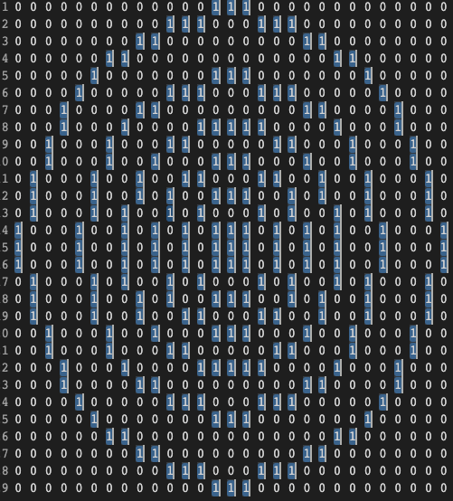
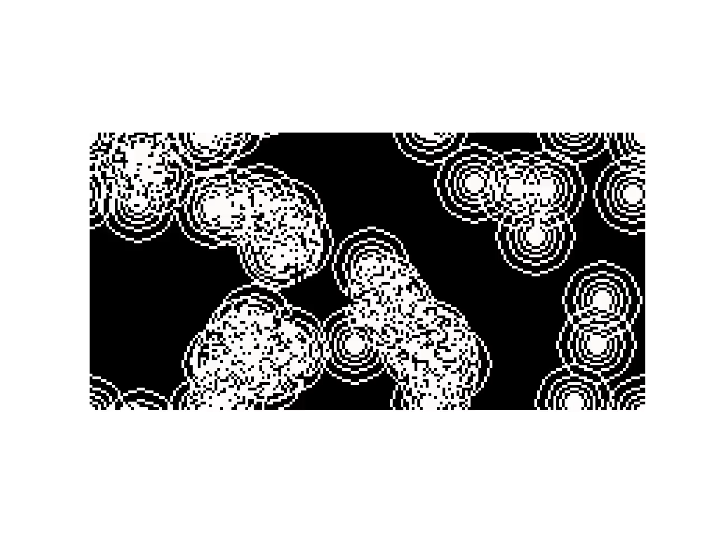
Population = 10, Generation = 10, nh=3
Output
mask_c1
mask_c2
mask_c3

Slide 19
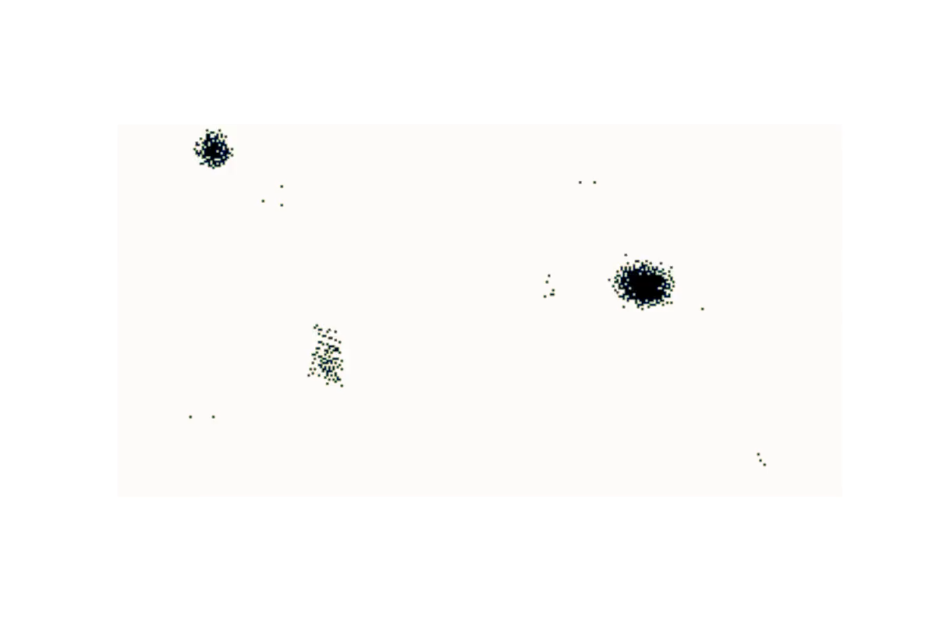
Population = 10, Generation = 10, nh=3
Output
mask_c1
mask_c2
mask_c3
FINAL BEST CHROMOSOME IS:
[[(0.739, 0.994, 0), (0.738, 0.748, 1)], [(0.642, 0.908, 1), (0.485, 0.559, 0), (0.13, 0.534, 1)], [(0.456, 0.975, 1), (0.284, 0.624, 0), (0.584, 0.682, 1), (0.556, 0.905, 1)]]

Slide 20
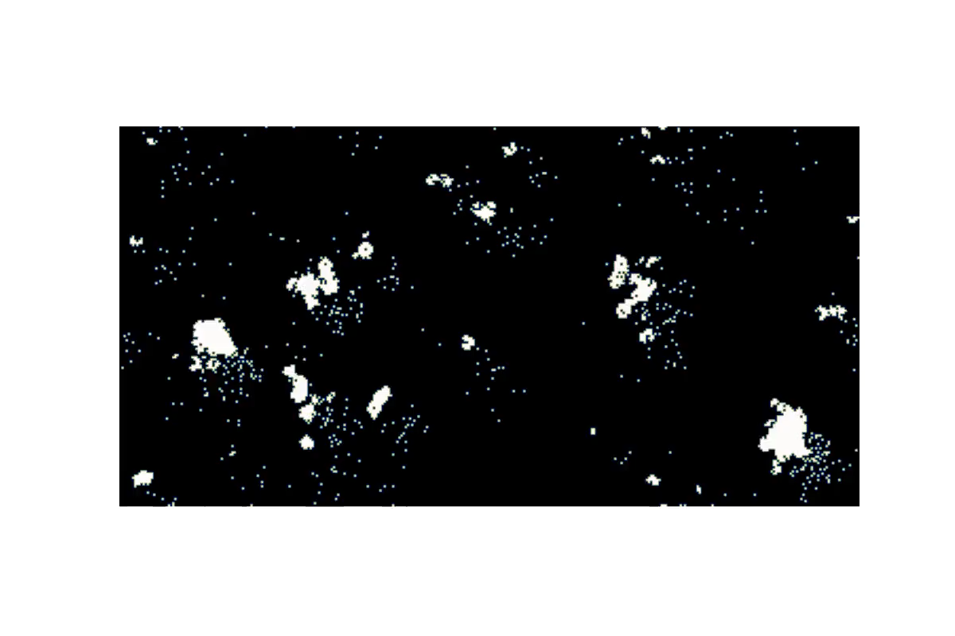
Population = 10, Generation = 10, nh=3
Output
mask_c1
mask_c2
mask_c3
FINAL BEST CHROMOSOME IS: [[(0.594, 0.946, 0), (0.427, 0.886, 1), (0.143, 0.617, 1)], [(0.056, 0.339, 1), (0.004, 0.013, 0), (0.685, 0.808, 1)], [(0.249, 0.464, 0), (0.312, 0.423, 0), (0.183, 0.37, 0)]]

Slide 21
References
[1]. https://en.wikipedia.org/wiki/Life-like_cellular_automaton
[2]. https://slackermanz.com/understanding-multiple-neighborhood-cellular-automata/

Slide 22
Thank You and Questions!

